Slide 1
No FrontEnd Framework
We made the experience

Slide 2
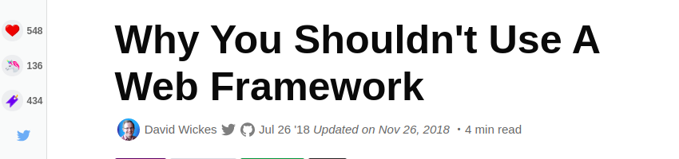

Slide 3
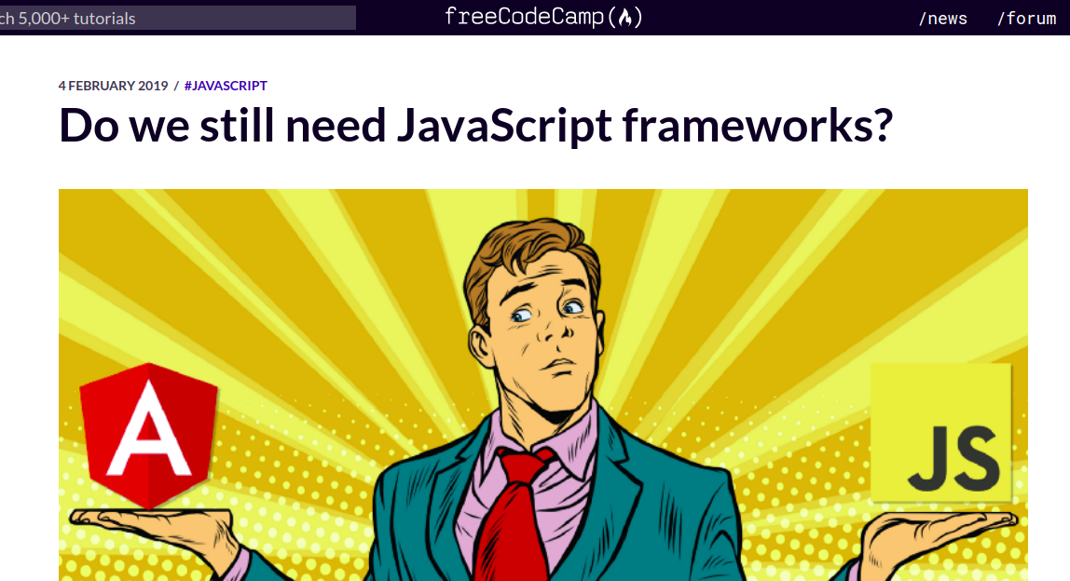

Slide 4
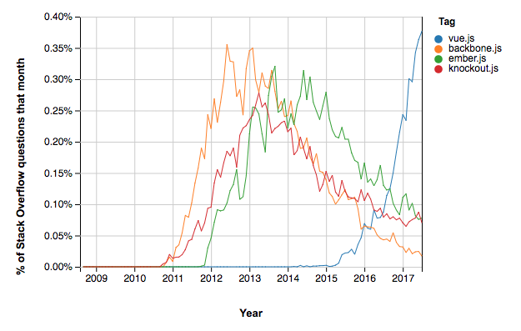
Frameworks Are Obsolete

Slide 5
You Don’t Know Your Code

Slide 6
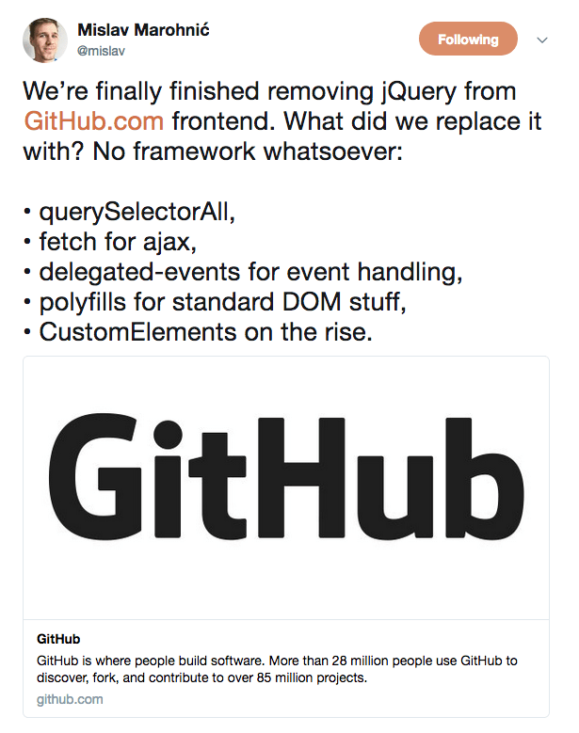

Slide 7
Modern JS is Great

Slide 8
So What’s a Framework ?

Slide 9
Implementation dependency
Compatibility Concerns

Slide 10
Web Components
(declarative in mind)

Slide 11
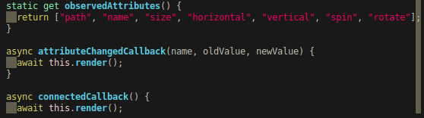

Slide 12
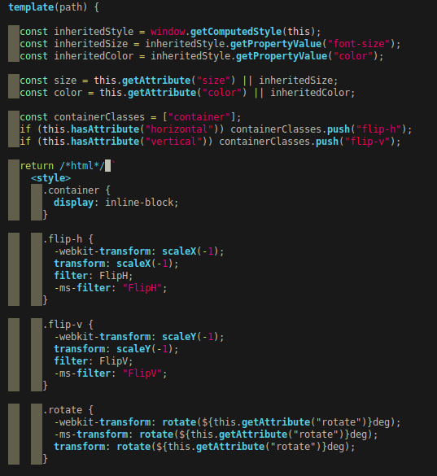

Slide 14
How to pass non primitive type variables ?

Slide 15
Make it Event-Driven
With Custom Events

Slide 16
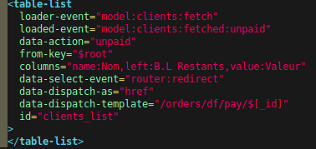

Slide 17
Conclusion:
Our code has a longer life
Our code is lighter
We learned the Real Javascript

Slide 18
Cons:
No EcoSystem
Not always simple

